Slide 1
Boolean Functions Homework
Popu Bianca – group 916

Slide 2
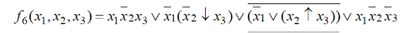
Problem Statement:
Exercise 3.6
Using Veitch diagrams, simplify the following Boolean function:

Slide 3

Theoretical Support:
Veitch Diagram = a circular diagram in which the cells are arranged so that there is only a single variable change between adjacent cells
Monom = a conjunction of variables
Minterm = a monom which contains all the variables present in the function
DCF = Disjunctive Canonical Form (the disjunction of the minterms)
Maximal Monoms = minterms or monoms obtained through factorization
Central Monoms = maximal monoms which cannot be covered by the disjunction of all the other maximal monoms of $f$
Factorization = process through which we obtain a monom representing the common part of other monoms (in this case, we obtain the maximal monoms of $f$)

Slide 4
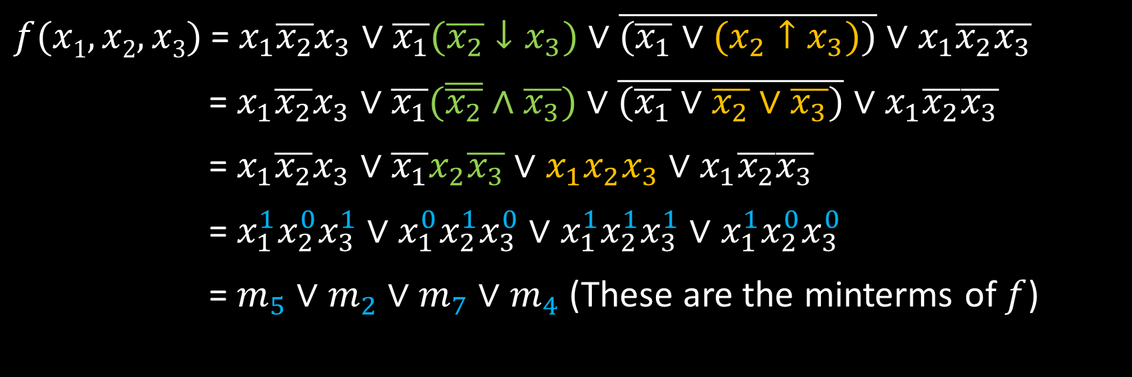
Step 1 – The initial function $f$ is transformed into DCF($f$)
$f(x1, x2, x3)$= $x_{1}\overline{x_{2}}x_{3}∨\overline{x_{1}}(\overline{x_{2}}↓x_{3})∨\overline{(\overline{x_{1}}∨(x_{2}↑x_{3}))}∨x_{1}\overline{x_{2}}\overline{x_{3}}$
= $x_{1}\overline{x_{2}}x_{3}∨\overline{x_{1}}(\overline{\overline{x_{2}}}∧\overline{x_{3}})∨\overline{(\overline{x_{1}}∨\overline{x_{2}}∨\overline{x_{3}})}∨x_{1}\overline{x_{2}}\overline{x_{3}}$
= $x_{1}\overline{x_{2}}x_{3}∨\overline{x_{1}}x_{2}\overline{x_{3}}∨x_{1}x_{2}x_{3}∨x_{1}\overline{x_{2}}\overline{x_{3}}$
= $x_{1}^{1}x_{2}^{0}x_{3}^{1}∨x_{1}^{0}x_{2}^{1}x_{3}^{0}∨$ $x_{1}^{1}x_{2}^{1}x_{3}^{1}∨$ $x_{1}^{1}x_{2}^{0}x_{3}^{0}$
= $m_{5}∨m_{2}∨m_{7}∨m_{4}$ (These are the minterms of $f$)

Slide 5
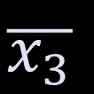
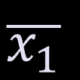
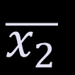
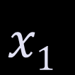
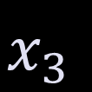

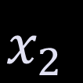
Step 2 – The Factorization Process
$$x1$$
$$\overline{x_{1}}$$
m₇ |  | m₂
m₅ | m₄
- Two groups of neighbouring minterms
$$x_{2}$$
- One isolated minterm
$$\overline{x_{2}}$$
$$x_{3}$$
$$\overline{x_{3}}$$
$$x_{3}$$

Slide 6
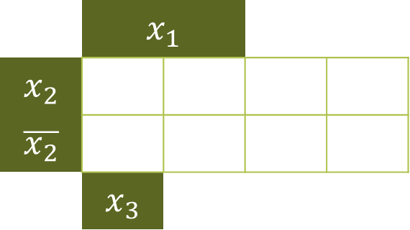

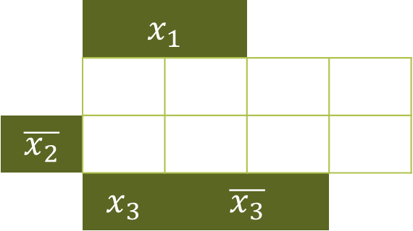
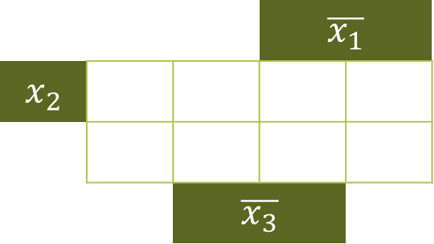
Simple factorization: Maximal monom: max1 = m₇ $∨$ m₅ = $x_{1}x_{3}$ | Simple factorization: Maximal monom: max2 = m₅ $∨$ m₄ = $x_{1}\overline{x_{2}}$
0 – factorization: Maximal monom: max3 = m₂ = $\overline{x_{1}}x_{2}\overline{x_{3}}$ | The set of maximal monoms: M($f$) = {max₁, max₂, max₃} ={$x_{1}x_{3}$, $x_{1}\overline{x_{2}}$, $\overline{x_{1}}x_{2}\overline{x_{3}}$}
 | $$x_{1}$$ |  | $$\overline{x_{1}}$$
$$x_{2}$$ | m₇ |  | m₂
$$\overline{x_{2}}$$ | m₅ | m₄
 | $$x_{3}$$ | $$\overline{x_{3}}$$ |  | $$x_{3}$$
 | $$x_{1}$$ |  | $$\overline{x_{1}}$$
$$x_{2}$$ | m₇ |  | m₂
$$\overline{x_{2}}$$ | m₅ | m₄
 | $$x_{3}$$ | $$\overline{x_{3}}$$ |  | $$x_{3}$$
 | $$x_{1}$$ |  | $$\overline{x_{1}}$$
$$x_{2}$$ | m₇ |  | m₂
$$\overline{x_{2}}$$ | m₅ | m₄
 | $$x_{3}$$ | $$\overline{x_{3}}$$ |  | $$x_{3}$$

Slide 7
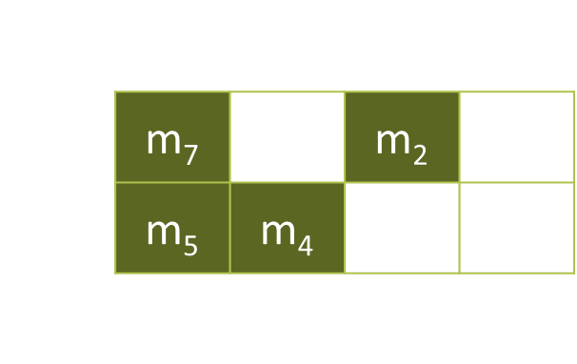

Step 3 – selecting the central monoms from the maximal monoms
All our maximal monoms are central monoms because their corresponding groups of minterms contain at least one minterm circled only once.
C($f$) = {max₁, max₂, max₃} = {$x_{1}x_{3}$, $x_{1}\overline{x_{2}}$, $\overline{x_{1}}x_{2}\overline{x_{3}}$}
The minterms covered by central monoms are shaded
 | $$x_{1}$$ |  | $$\overline{x_{1}}$$
$$x_{2}$$ | m₇ |  | m₂
$$\overline{x_{2}}$$ | m₅ | m₄
 | $$x_{3}$$ | $$\overline{x_{3}}$$ |  | $$x_{3}$$

Slide 8

Step 4 – Identifying the case of the simplification algorithm
M($f$) = C($f$) => The first case of the simplification algorithm.
There is a unique simplified form of $f$, obtained as a disjunction of all central monoms:
$f^{S}(x_{1},x_{2},x_{3})$ = max1 $∨$ max2 $∨$ max3 = $x_{1}x_{3}$ $∨$ $x_{1}\overline{x_{2}}$ $∨$ $\overline{x_{1}}x_{2}\overline{x_{3}}$

